Slide 1

KONGU ENGINEERING COLLEGE
PERUNDURAI ERODE-638060
DEPARTMENT OF AUTOMOBILE ENGINEERING
Team Captain: KOUSHIK KANNA G
Vice Captain: KARTHIK S
Driver: LINIYTH KUMAR U
Team Members: ARUVI B
SURYA PRAKASH S
SAKTHIVEL S
MONIGA B
Team Mentor with Designation and Department:
Dr. P. C. Murugan /Associate Professor / Auto. Engg.
1

Slide 2


SAEISS Bicycle Design Competition 2022-2023
Team ID :BDC2023034
Team Name : CRANKY
2

Slide 3

TEAM OBJECTIVE
To develop a design for SAEINDIA (southern section) for bicycle challenge 2023.
To develop a bicycle for people affordable price.
To provide better seating for passenger comfort.
Riding a our cycle can help build strength in your legs and lower body, especially if you use a higher resistance.
The pedaling action can help strengthen your calves, hamstrings, and quadriceps. Additionally, it can work the muscles in your core, back, and glutes.

Slide 4
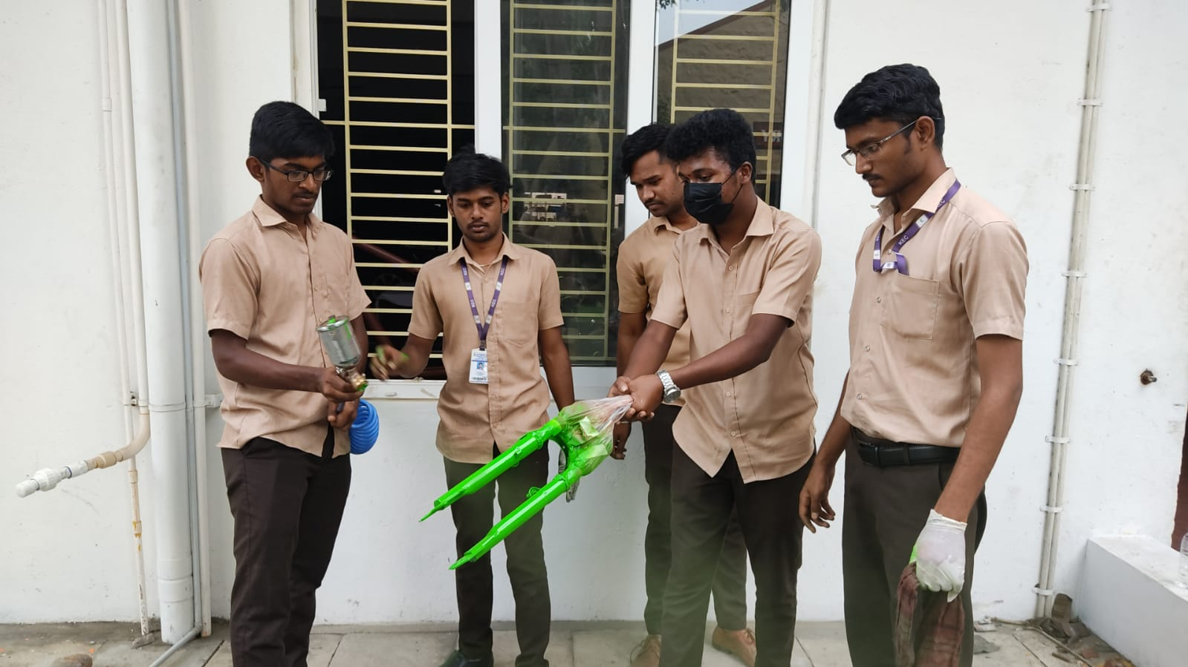
CHALLENGES
The design and analysis is very challenging to us, because sometimes the analysis is more deform.
Sometimes the design is not cost efficient, we can modify our design into cost efficient.
We have to many difficulty to develop a product but finally we achieve it.

Slide 5
LESSONS LEARNT (OLD TEAMS)
To learn many things about cycles like if we give some force in the particular area, what are the deformation are happened.
To learn about the software handling.
Also we learn, before and after procedure about the main things like painting, bending.

Slide 6
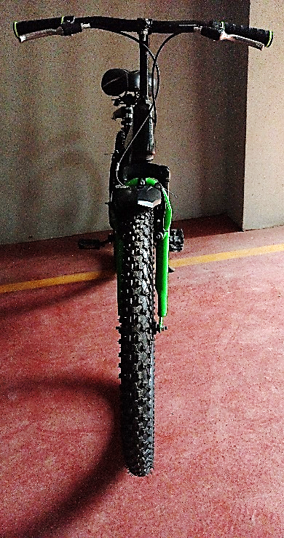
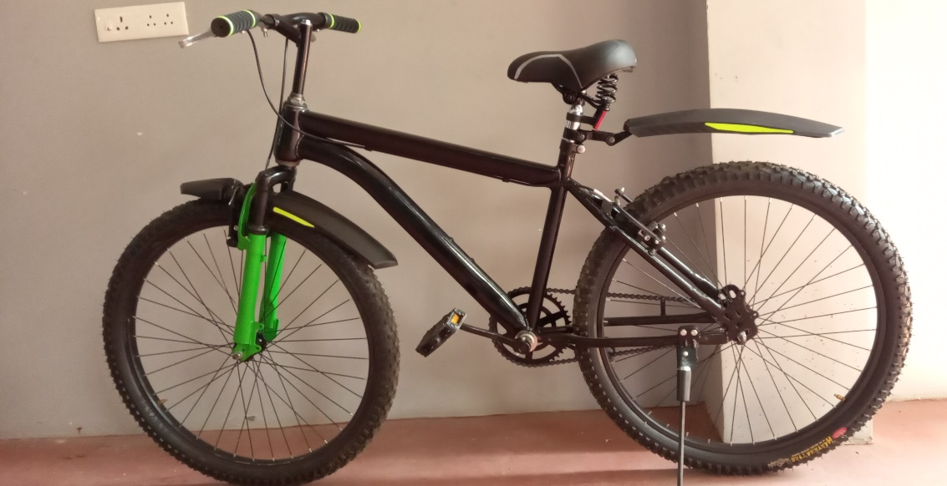
VEHICLE SPECIFICATION
Frame length : 540mm
Overall weight of the cycle : 18.07kg
Frame : Steel Alloy
Brake : Front (V-Brake)
Rear (V-Brake)
Pedals : Steel Alloy

Slide 7
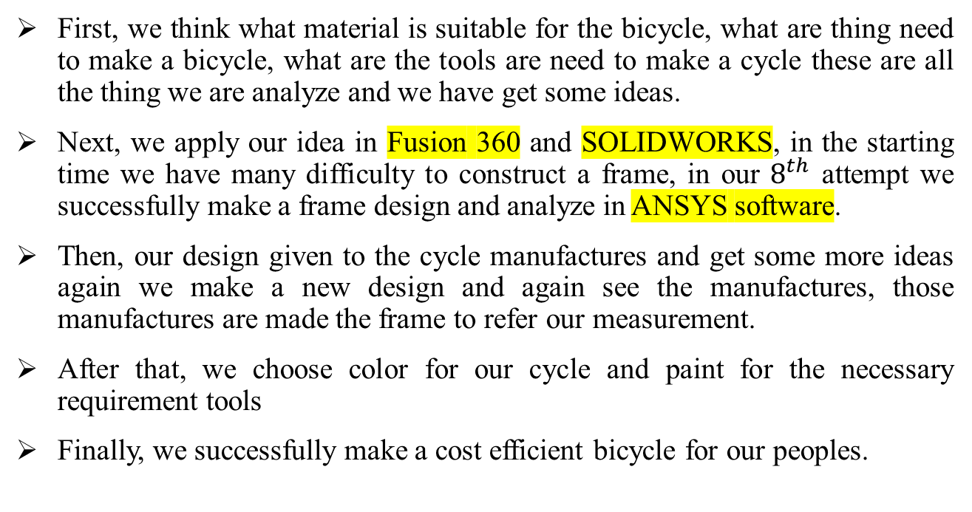
FRAME DESIGN PROCESS AND ERGONOMICS
First, we think what material is suitable for the bicycle, what are thing need to make a bicycle, what are the tools are need to make a cycle these are all the thing we are analyze and we have get some ideas.
Next, we apply our idea in Fusion 360 and SOLIDWORKS, in the starting time we have many difficulty to construct a frame, in our $8^{th}$ attempt we successfully make a frame design and analyze in ANSYS software.
Then, our design given to the cycle manufactures and get some more ideas again we make a new design and again see the manufactures, those manufactures are made the frame to refer our measurement.
After that, we choose color for our cycle and paint for the necessary requirement tools
Finally, we successfully make a cost efficient bicycle for our peoples.

Slide 8
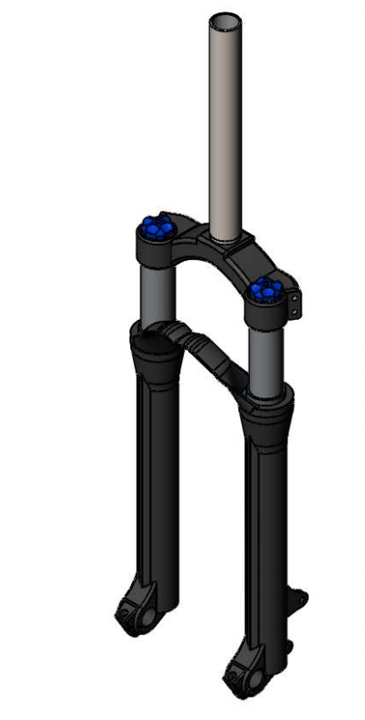
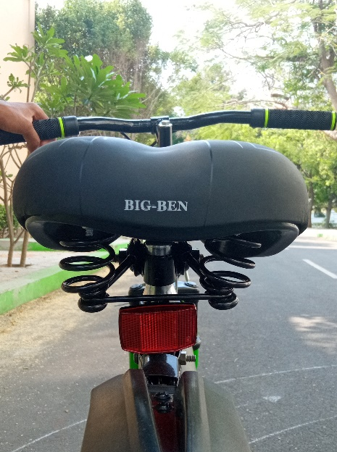
SUSPENSION
We have the suspension in seat and shock absorber in fork.

Slide 9
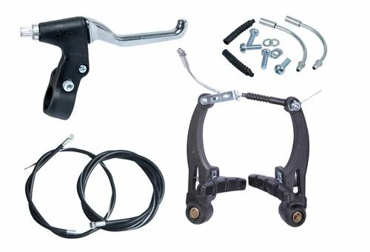
BRAKES
A bicycle brake reduces the speed of a bicycle or prevents it from moving.
Our cycle frame arrangement is convenient both disc brakes, V-brakes.
Our cycle is 50 mm diameter connect the V-brake.
The customer can also want to choose either a V-brake or disc brake.

Slide 10
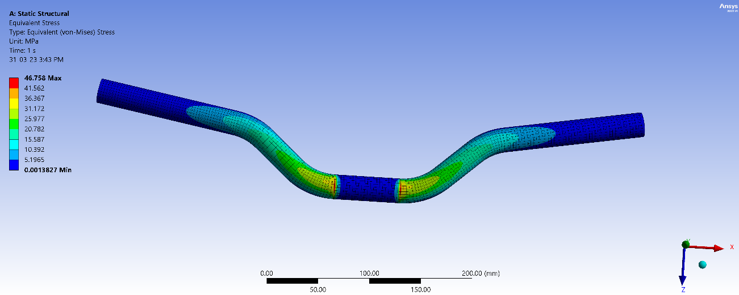
STEERING
Our cycle steering overall length is 605 mm and the steering measurements is handle 12.5mm length and middle portion 35.5mm length.
Steering is medium length because the turning is convenient to peoples.

Slide 11
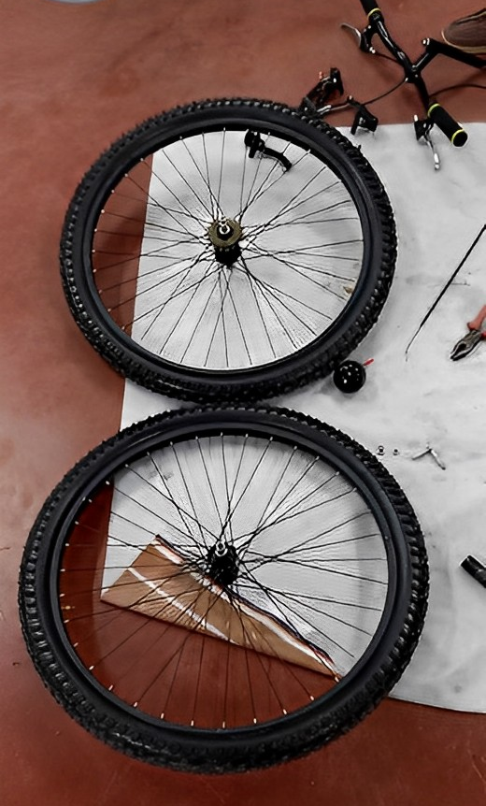
TRANSMISSION AND WHEEL ASSEMBLY
The space is sufficiently enough for the concern of the rider.
This adopt the greater transmission and the wheel is fixed in the position to give higher transmission power.

Slide 12
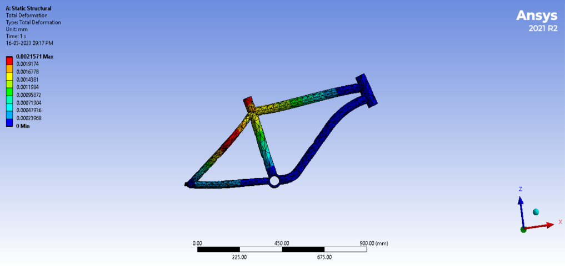
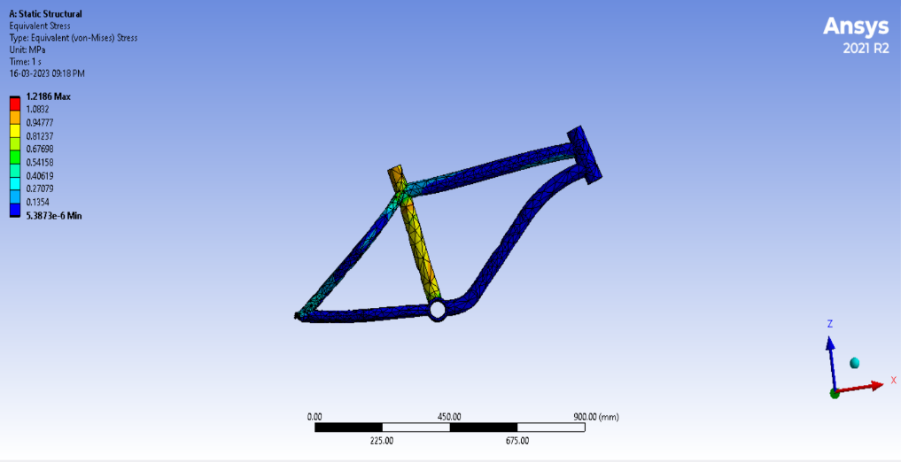
CAE PROCESS
We use the Fusion 360 to create our design and we analyze in ANSYS software.
This analyze give as an maximum load withstand property

Slide 13
COST AND WEIGHT ANALYSIS (OLD VS NEW)
S. No | Part Groups | Cost (Rs. )
1. | Frame | 976.75
2. | Fork Assembly | 1200.75
3. | Brake Assembly | 350
4. | Crank System | 380
5. | Front Wheel Assembly | 205
6. | Rear Wheel Assembly | 210
7. | Saddle & Stand | 174
8. | Steering | 270
9. | Miscellaneous, Fit & Finish | 90
10. | Painting & Stickering | 464
Total 4320

Slide 14
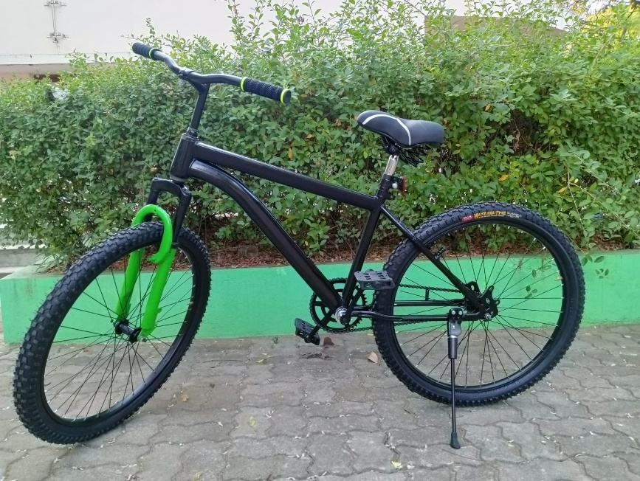
COST AND WEIGHT ANALYSIS
This slide is subjected to newer teams.
Type : steel alloy
The total cost of the cycle is ₹4320.
The total weight of the cycle is 18.07kg.
This cost is affordable for the normal people.

Slide 15
PROJECT PLAN VS. ACTUAL
In our project plan is more similar to the actual model
In our cycle plan we demonstrate in the software planning but in the reality model there are some little bit measurement is different (more or less 5 mm difference).

Slide 16
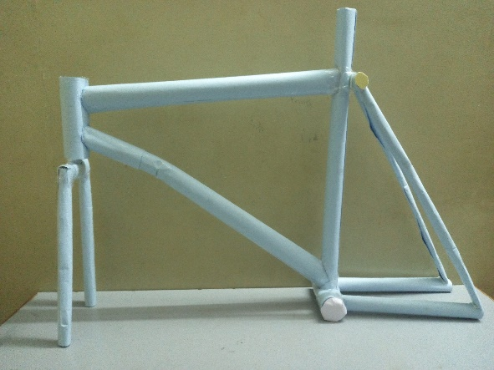
DVP (Design Verification Plan)
Our bicycle is a great way to stay active and reduce
my carbon footprint. Not only is it a great way to get
around town, but it also provides me with a low-impact
exercise option.
It helps me stay in shape, and I can get to my destination quickly and safely.
Additionally, it helps me save money on gas and reduces my environmental impact.
With my bicycle, I can explore new places and discover hidden gems in my city. It's an enjoyable and sustainable way to travel.

Slide 17
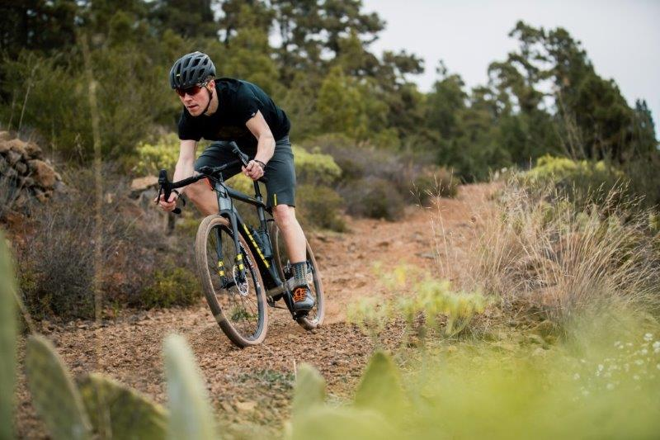
Innovation
We can increase the stability of the frame.
This type of cycle is both useful for mountain sides as well as normal roads.

Slide 18

Thank you
Students are asked to enter your full team members list with captain, vice captain, driver highlighted.
Team captain : Koushik kanna G
Vice Captain : Karthik S
Driver : Liniyth kumar U
Team members : Aruvi B
Surya prakash S
Sakthivel S
Moniga B

